Slide 1
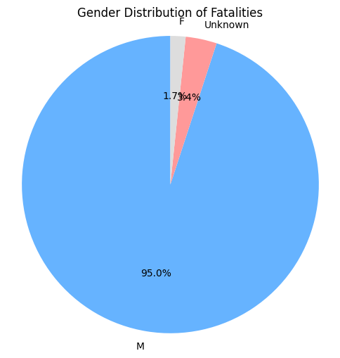
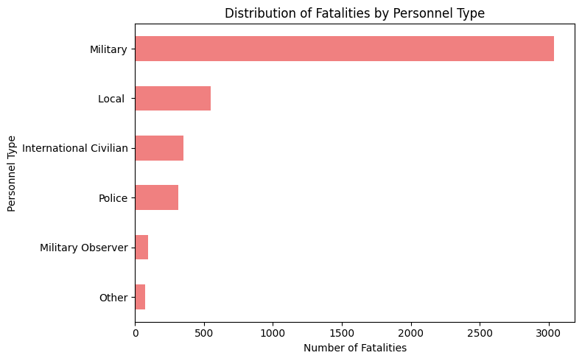


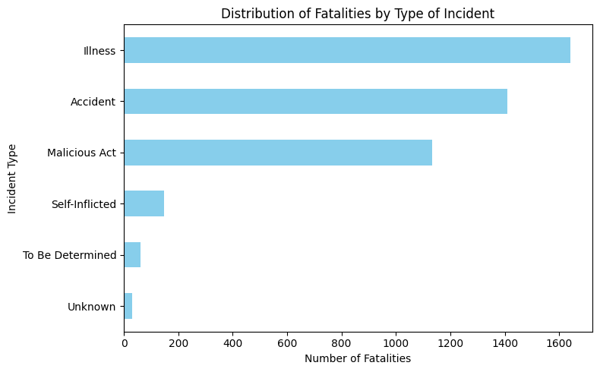
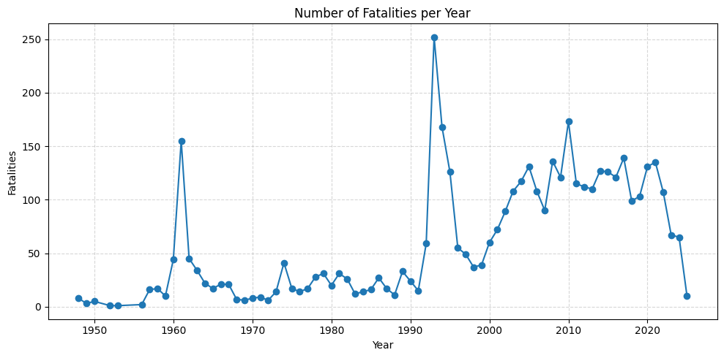


Peacekeeping Fatalities: Key Insights (1948–2025)
1. Gender Distribution (Pie Chart)
95% of fatalities are male, highlighting male-dominant risk exposure.
2. Incident Type (Bar Chart)
Illness & accidents = top causes, but 1 in 4 deaths are from malicious acts.
4. Fatalities Over Time (Line Chart)
3. Personnel Type (Bar Chart)
Military personnel face highest fatalities (~68%),
Deaths spike in certain years, indicating links to specific conflicts/missions.
reflecting their frontline role.

Slide 2
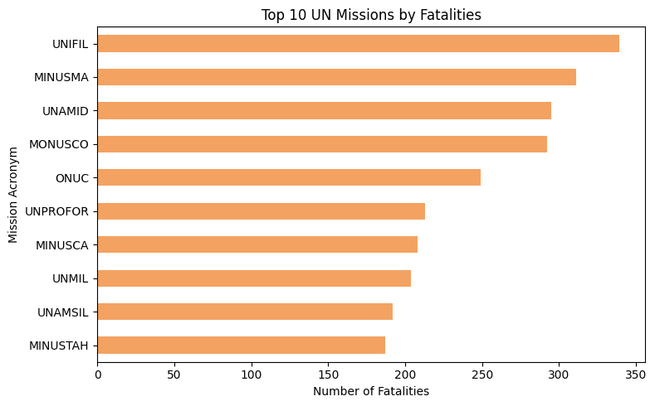
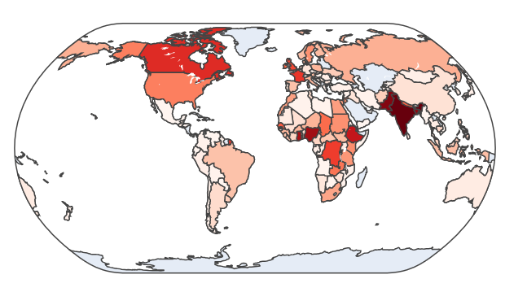
Recommendations & Strategic Takeaways
Top 10 Missions by Fatalities
Focus additional security on missions with historically high fatality rates (e.g., UNIFIL, MINUSMA).
Expand health interventions to reduce illness-related deaths (~37% of all cases).
Increase psychological support in light of self-inflicted deaths and operational stress.
Global Heatmap
Monitor nationality-level fatalities for equity and targeted training (India, Pakistan, Bangladesh lead).
Promote equitable risk-sharing among troop-contributing countries by reviewing deployment allocations and mission assignments.
Use country-specific fatality trends to inform pre-deployment training, emphasizing mission-specific threats and regional conditions.

